Slide 1
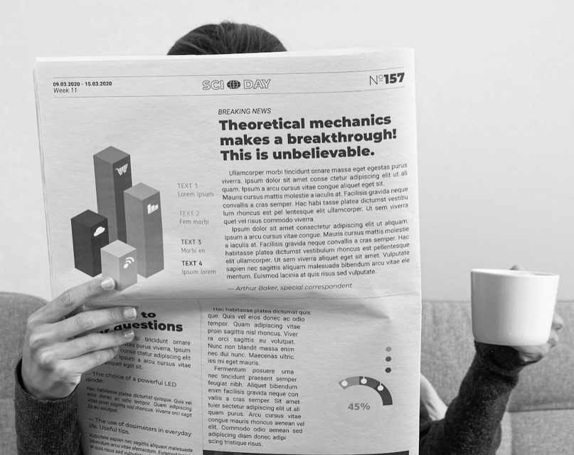
The Daily News
Thursday 09/11/2023
News
Edition: 001
“Here is where this template begins”
By Jyotsna, Asha, Priya, Taryn

Slide 2
Front page news
Thursday 09/11/2023
News
Edition: 001
The problem
The challenge of differentiating between real and fake news
The objective
To create a tool that can classify news articles as real or fake using machine learning techniques
The data
Fake news articles: 17, 903
Real news articles: 21,191
Primary source from Reuters
Over 90% articles from the USA
Real news 47.5% Fake news 52.5%
Real news contained approx. 500 words per article, fake news at 250

Slide 3
Your title
Thursday 09/11/2023
News
Edition: 001

Slide 4
Your title
Thursday 09/11/2023
News
Edition: 001

Slide 5
What’s the story?
Thursday 09/11/2023
Infographics
Edition: 001
The main findings and resulting analysis from the dataset shows some fascinating insights into the details of fake news articles and the comparison to real articles.
In general, fake news articles are shorter by 50% on average than real news
In both sets of real and fake news data, whilst the names of both presidential candidates are frequently used over 10,000 times as well as 'republican’, in fake news the other 'democrat' party does not appear. The dataset reflects the hot political climate, dominating the news cycle at the time with further popular words and trigrams including 'North Korea', 'president barack obama', 'president united states', 'black life(sic)matter' and 'white house say(sic)'.
The analysis shows that in real news, formal titles and language are most commonly used in this style of writing Different words on this data set include 'want', 'work', 'vote', man','american' ,'right', 'take', 'go', 'tell' and 'woman' which are less formal and more emotive than the real news data set
Sentiment analysis shows that fake news has a slightly higher negative sentiment than real news and frequently used words follow a theme and very little neutral sentiment (.4%) in fake news.

Slide 6

THANK YOU

Slide 7
OTHER TEMPLATES TO USE
Thursday 09/11/2023
News
Edition: 001

Slide 8
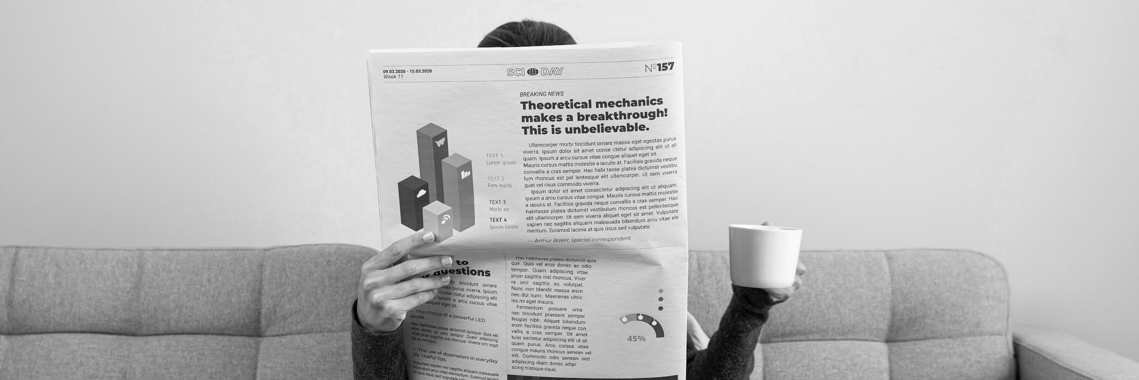
The Daily News
Thursday 09/11/2023
News
Edition: 001
“Here is where this template begins”

Slide 9
The daily news infographics
Venus
Thursday 09/11/2023
News
Edition: 001
60%
50%
Mars
Venus is the second planet from the Sun
Despite being red, Mars is a cold place
40%
Jupiter
25%
Saturn
It’s the biggest planet in the Solar System
Saturn is a gas giant and has several rings

Slide 10
The daily news infographics
Friday 08/05/2xxx
Infographics
Edition: 001
Mars
Despite being red, Mars is actually a cold place
Venus
Venus is the second planet from the Sun
Jupiter
Jupiter is the biggest planet in the Solar System
Mercury
Mercury is the smallest planet of them all
Neptune
Neptune is the farthest planet from the Sun

Slide 11
The daily news infographics
Venus
Friday 08/05/2xxx
Infographics
Edition: 001
90%
75%
50%
Mars
Jupiter
Venus is the second planet from the Sun
Despite being red, Mars is a cold place
It’s the biggest planet in the Solar System

Slide 12
The daily news infographics
Friday 08/05/2xxx
Infographics
Edition: 001
01
Mercury
04
Saturn
It’s the closest planet to the Sun
It’s composed of hydrogen and helium
Last important news
02
Jupiter
05
Mars
Jupiter is the biggest planet of them all
Mars is actually a very cold place
03
Venus
06
Neptune
Venus is the second planet from the Sun
It’s the farthest planet from the Sun

Slide 13
The daily news infographics
Friday 08/05/2xxx
Infographics
Edition: 001
60%
News 1
Mercury is the closest planet to the Sun
40%
News 2
Despite being red, Mars is a cold place
20%
News 3
Venus is the second planet from the Sun
80%
News 4
Jupiter is the biggest planet of them all

Slide 14
The daily news infographics
Friday 08/05/2xxx
Infographics
Edition: 001
Chris Smith
Dan Do
Jack Robson
“Mercury is the smallest planet”
“Venus is the second planet from the Sun”
“Mars is actually a very cold place”
Dianne Trots
Anne Marie
Zu Cho
“Jupiter is the biggest planet of them all”
“Saturn is a gas giant with several rings”
“Neptune is far away from Earth”

Slide 15
The daily news infographics
Friday 08/05/2xxx
Infographics
Edition: 001
Mercury
It’s the closest planet to the Sun
Jupiter
Jupiter is the biggest planet of them all

Slide 16
The daily news infographics
Friday 08/05/2xxx
Infographics
Edition: 001
Mercury
01
02
Saturn
It’s the closest planet to the Sun
It’s composed of hydrogen and helium
Jupiter
06
03
Mars
Jupiter is the biggest planet of them all
Mars is actually a very cold place
Venus
05
04
Neptune
Venus is the second planet from the Sun
It’s the farthest planet from the Sun

Slide 17
The daily news infographics
News 1
Friday 08/05/2xxx
Infographics
Edition: 001
News 2
News 3
Venus is the second planet from the Sun
Despite being red, Mars is a cold place
Jupiter is the biggest planet of them all
Describe your news here
Describe your news here
Describe your news here
Describe your news here
Describe your news here
Describe your news here
Describe your news here
Describe your news here
Describe your news here
Describe your news here
Describe your news here
Describe your news here

Slide 18
The daily news infographics
Friday 08/05/2xxx
Infographics
Edition: 001
A
B
C
D
Mercury
Jupiter
Venus
Earth
It’s the closest planet to the Sun
It’s the biggest planet of them all
Venus has a very toxic atmosphere
Earth is where we all live together
80%
60%
50%
45%

Slide 19
The daily news infographics
Friday 08/05/2xxx
Infographics
Edition: 001
News summary
Week 1 | Week 2 | Week 3 | Week 4
Mercury is the closest planet to the Sun | Earth is the planet with life | Venus has extremely high temperatures | Mars is full of iron oxide dust
Mars is actually a very cold place | Neptune is the farthest planet from the Sun | The Moon is Earth’s only natural satellite | Jupiter is the biggest planet of them all
Ceres is located in the main asteroid belt | Pluto is considered a dwarf planet | Saturn is not the only planet with rings | Mercury is the smallest planet

Slide 20
The daily news infographics
Friday 08/05/2xxx
Infographics
Edition: 001
A
B
C
News A
News C
Mercury is the smallest planet
Venus has a beautiful name
News B
90%
50%
Jupiter is the biggest planet
75%

Slide 21
The daily news infographics
Friday 08/05/2xxx
Infographics
Edition: 001
Online
Print
Mercury is the smallest planet
Main readers
Jupiter is the biggest planet
60%
40%

Slide 22
The daily news infographics
Friday 08/05/2xxx
Infographics
Edition: 001
Sport news
Men
Women
Earth is the third planet from the Sun and the only one that harbors life in the Solar System. This is where we all live
Mercury is the closest planet to the Sun and the smallest one
Venus has a beautiful name and is the second planet from the Sun
60%
40%
Age of readers
25-35 years
36-45 years

Slide 23

The daily news infographics
Friday 08/05/2xxx
Infographics
Edition: 001
11%
35%
Sports
Sensational
Saturn is a gas giant with several rings
Mercury is the closest planet to the Sun
24%
30%
Business
Politic
Venus is the second planet from the Sun
Despite being red, Mars is actually a cold place
Follow the link in the graph to modify its data and then paste the new one here. For more info, click here

Slide 24
The daily news infographics
Friday 08/05/2xxx
Infographics
Edition: 001
60%
50%
40%
20%
News A
News B
News C
News D
Mercury is the smallest planet
Jupiter is the biggest planet
Venus has a very toxic atmosphere
Earth is the planet where we all live

Slide 25
The daily news infographics
Friday 08/05/2xxx
Infographics
Edition: 001
Print
Online
Mercury is the closest planet to the Sun and the smallest one in the Solar System—it’s only a bit larger than the Moon
Venus has a beautiful name and is the second planet from the Sun. It’s hot and has a poisonous atmosphere
137 million
145 million
A week
A day

Slide 26
The daily news infographics
Friday 08/05/2xxx
Infographics
Edition: 001
Big news
Business
Local news
Despite being red, Mars is a cold place
Earth is the third planet from the Sun
World news
Death notices
Weather
Venus is the second planet from the Sun
Mercury is the smallest planet
Saturn is a gas giant with rings

Slide 27
The daily news infographics
Friday 08/05/2xxx
Infographics
Edition: 001
Soft news
Venus has a beautiful name and is the second planet from the Sun. It’s terribly hot, even hotter than Mercury, and its atmosphere is extremely poisonous
Sports |  | Celebrity gossip
Entertainment |  | Editorial
Food |  | Obituary
Travel |  | Horoscopes

Slide 28
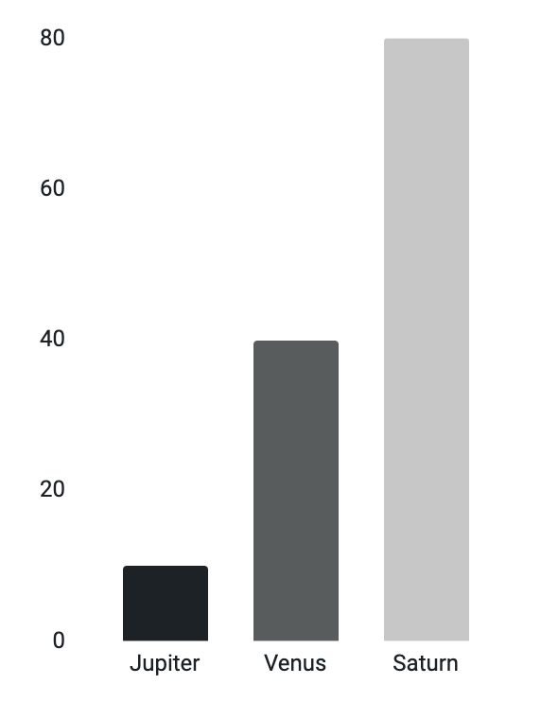
The daily news infographics
Friday 08/05/2xxx
Infographics
Edition: 001
Important information
International news
Venus is the second planet from the Sun
Ceres is located in the main asteroid belt
Jupiter
Mars
Jupiter is big
Despite being red, Mars is actually a cold place, not hot. It’s full of iron oxide dust
Venus
Venus is hot
Earth is where we all live
Saturn
Saturn has rings
Follow the link in the graph to modify its data and then paste the new one here. For more info, click here

Slide 29
The daily news infographics
Friday 08/05/2xxx
Infographics
Edition: 001
Business
Politics
Mercury is the smallest planet
Mars is actually a very cold place
11 am
1 pm
3 pm
6 pm
9 pm
Weather
Celebrity
Horoscope
Jupiter is the biggest planet
Earth is where we all live together
Neptune is far away from Earth

Slide 30
The daily news infographics
News A
News B
Friday 08/05/2xxx
Infographics
Edition: 001
Venus has a very beautiful name
Jupiter is the biggest planet of them all
Describe your news here
Describe your news here
Describe your news here
Describe your news here
Describe your news here
Describe your news here
Describe your news here
Describe your news here
75%
25%
News A
News B
Mercury is the smallest planet
Saturn is a gas giant with rings

Slide 31
The daily news infographics
Friday 08/05/2xxx
Infographics
Edition: 001
Mercury
Mars
It’s the closest planet to the Sun
Mars is actually a very cold place
Earth
Earth is the third planet from the Sun
Jupiter
Neptune
It’s the biggest planet of them all
It’s the farthest planet from the Sun

Slide 32
The daily news infographics
Friday 08/05/2xxx
Infographics
Edition: 001
 | News 1 | News 2 | News 3 | News 4 | News 5 | News 6
9-10 am | Politics
10-11 am |  | Police
11-12 pm |  |  | Weather
12-1 pm |  |  |  | Sport
1-2 pm |  |  |  |  |  | Travel
2-3 pm |  |  |  |  |  | Food

Slide 33
The daily news infographics
Venus
Friday 08/05/2xxx
Infographics
Edition: 001
Saturn
Venus is the second planet from the Sun
It’s composed of hydrogen and helium
Jupiter
Mercury
It’s the biggest planet in the Solar System
It’s the closest planet to the Sun
Mars
Neptune
Despite being red, Mars is a cold place
It’s the farthest planet from the Sun

Slide 34
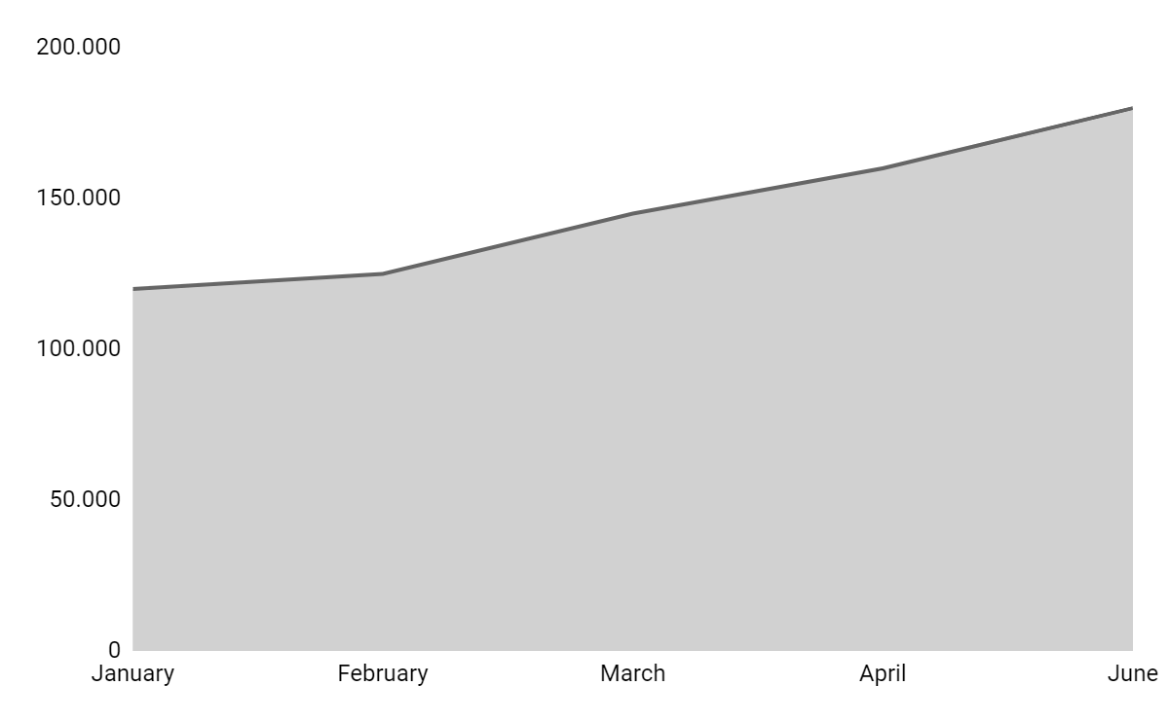
The daily news infographics
Friday 08/05/2xxx
Infographics
Edition: 001
Trend
$180,000
Despite being red, Mars is actually a cold place, not hot. It’s full of iron oxide dust
Follow the link in the graph to modify its data and then paste the new one here. For more info, click here

Slide 35
The daily news infographics
Friday 08/05/2xxx
Infographics
Edition: 001
Mercury
Venus
Mercury is the closest planet to the Sun
Venus is the second planet from the Sun
50%
60%
20%
Jupiter
40%
Mars
Jupiter is the biggest planet of them all
Mars is actually a very cold place, not hot

Slide 36
The daily news infographics
Venus
455,000
Friday 08/05/2xxx
Infographics
Edition: 001
A
Venus is the second planet from the Sun
B
Jupiter
Jupiter is the biggest planet in the Solar System
320,000
C
Mars
Despite being red, Mars is a cold place
180,000

Slide 37
The daily news infographics
Friday 08/05/2xxx
Infographics
Edition: 001
Daily schedule
Hour | Topic | News
8-10 am | Weather | Jupiter is the biggest planet of them all
10-12 am | Business | Mercury is the closest planet to the Sun
12-2 pm | Celebrity | Earth is where we all live together
2-4 pm | Entertainment | Mars is actually a very cold place
4-6 pm | Politics | Neptune is far away from Earth

